Slide 1
Presentation on:
Sell and Buy application(OpenShop) for android platform

Slide 2
Mentor:
Team Members:
Kundan Nayak(20174018)
Keval Kushwaha(20174027)
Kapil Kumar(20174161)
Dr. J Sathish Kumar

Slide 3
Presentation Outline:
Introduction
Objectives
Technology Platform Overview
Application Feature Overview
Implementation
Application Snapshots
Limitations
Future Work
Conclusion

Slide 4
Introduction
Smart phone have become increasingly popular in recent years. And for almost everything there is an android application available whether it is a game, business, payment methods etc.
Our project is an android app which provides a platform for our college students to sell and buy used products without the involvement of any third party. By using this app students can find those products which has been used by some other students at low prices and sell those product which are no longer useful for them at reasonable price.

Slide 5
Objectives of the Project
The prime objective of this project is to develop a full fledged android application which could be able to provide a platform to buy and sell the used goods among college students.
Reduce the involvement of any third party(like here in our college students first used to sell their books to Gyan Traders at low price and purchase from them at more price).
Making use for technology for real life problems.

Slide 6
Academic Obejectives
Learn the process of android application development.
Understand how Android application works, their life cycle etc.
Design and develop useful Android application with compelling user.
Learn about how Google's Firebase works

Slide 7
Technology Platform
Mobile Platform: Android
Frontend Tool: Android Studio
Developing Language: Java
User Interface Language: XML
Backend: Google's Firebase

Slide 8
Reasons for choosing Android :
Android is open source.
Almost every development tools for android is free.
Huge reach as very large population is using android nowdays.
Huge resource available.

Slide 9
Application feature Overview:
Sign Up Activity for new user with email verification.
Sign In Activity for existing user.
Password recovery in case one forgot its password
Profile section of User
List of products available to buy.
Selling for products with its image and description
Forwarding Buy Request/Message to seller in case any buyer wants to purchase any product, so that both seller and buyer can communicate through email.

Slide 10
Implementation
Tools and Technology:
Android Studio
Firebase
Java 8
XML
Build Configuration:
Api 23: Android 6.0(marshmallow)
Gradle: 3.2.0

Slide 11
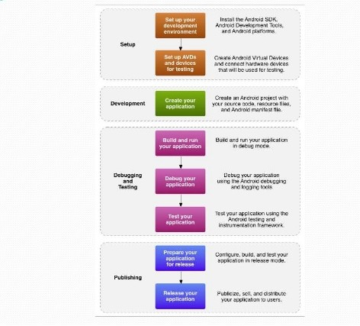
Methdology

Slide 12
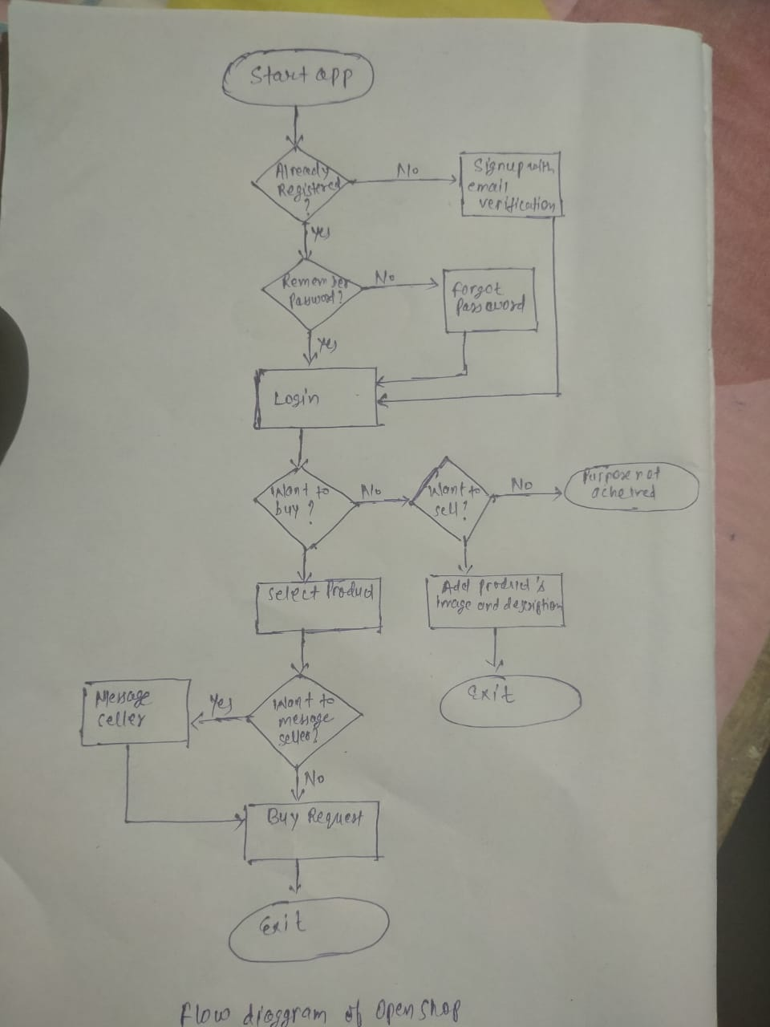
Flow Diagram

Slide 13
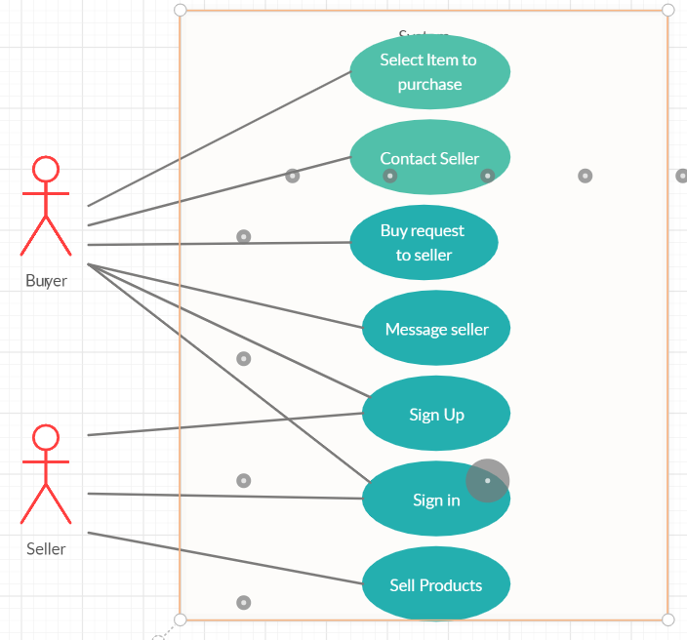
Use Case Diagram

Slide 14
Snapshots of our project
Few upcoming slide will hoghlight the result of our project and the snapshots of each of the activities are shown along with the discussion. Every steps of our application "Open Shop" will be described.

Slide 15
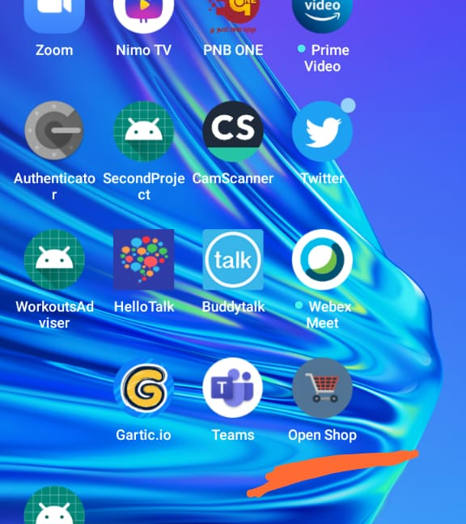
icon
The red coloured icon represent the "Open Shop" application. Clicking on this result to the sign in activity if user is not logged in. If user is already logged in it will result in main activity.

Slide 16
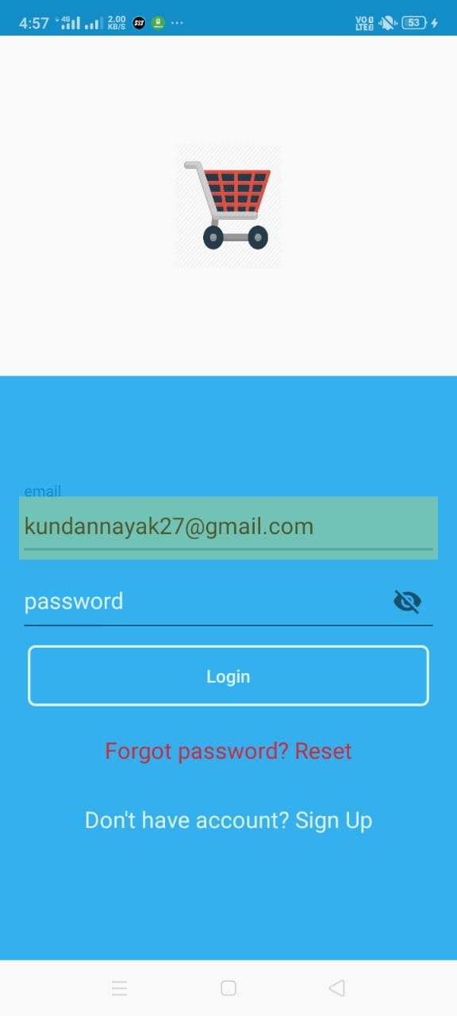
Login Activity
If user is have registered himself/herself to this app. He/She can login to this app by providing email and password.
If user is not registered, click on "Don't have an account?Sign Up"
If user is registered and forgets his/her password he/she can recover it through email after clicking on "Forgot password?Reset".

Slide 17
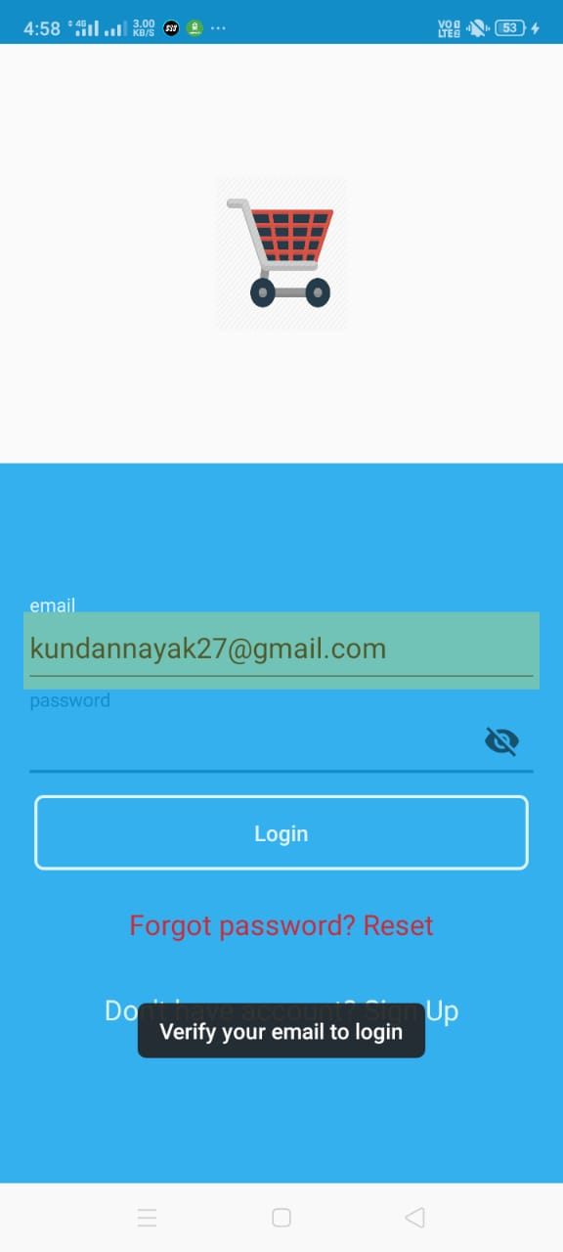
Sign Up Activity
This is the Signup Activity. After providing email and password(password should be strong unless app won't accept it), an email will be sent for verification.

Slide 18
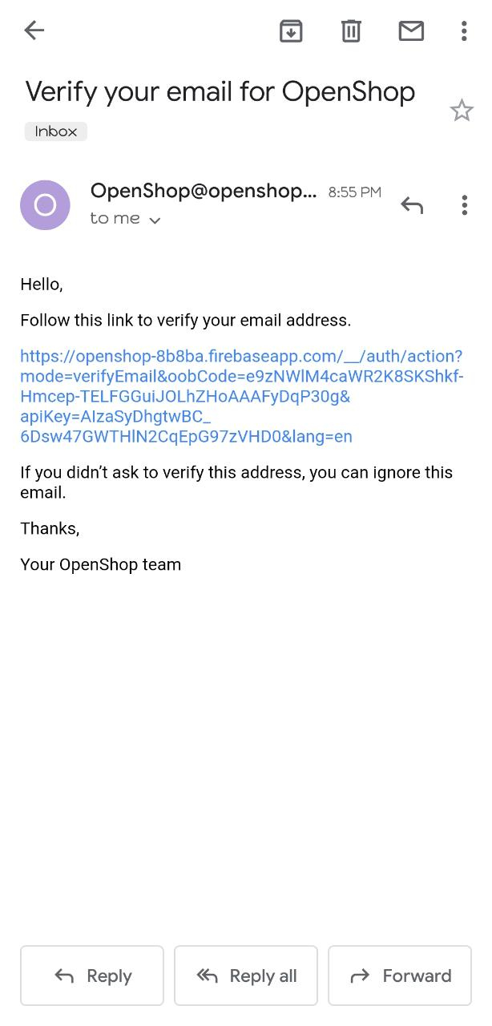
Verification email snapshot

Slide 19
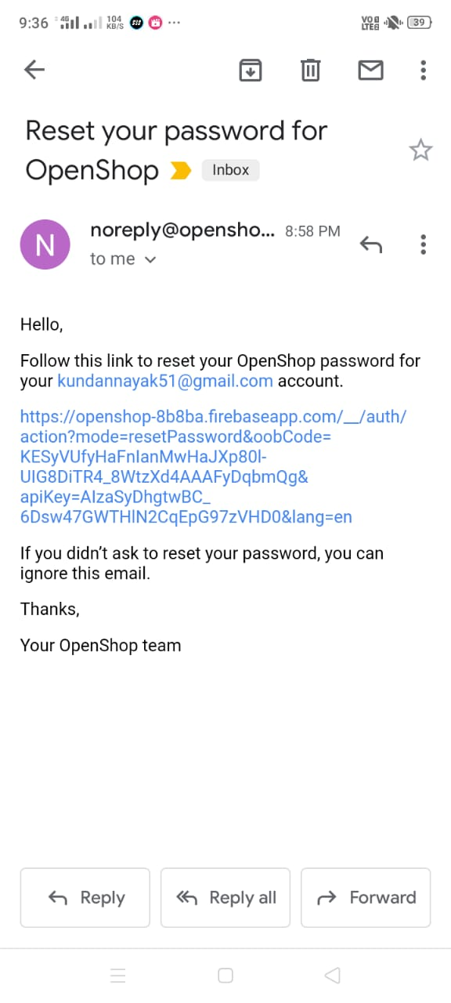
Reset password email snapshot

Slide 20
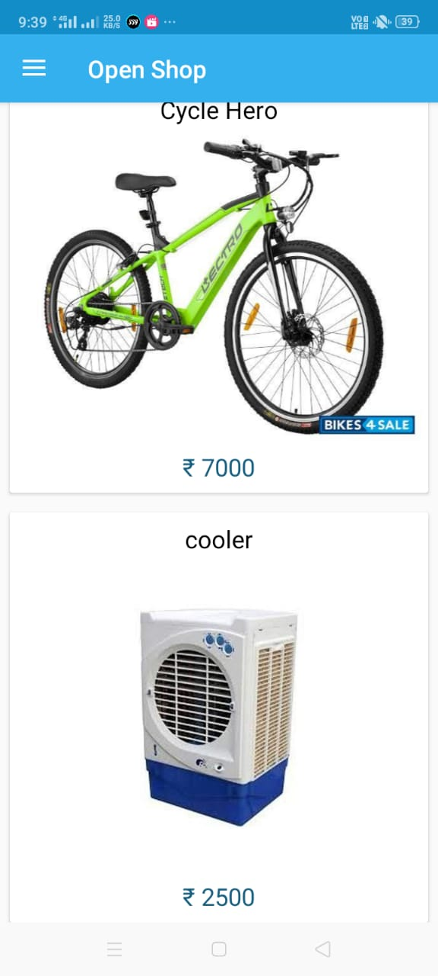
Home Activity
Will show the list of products that available to be purchased.

Slide 21
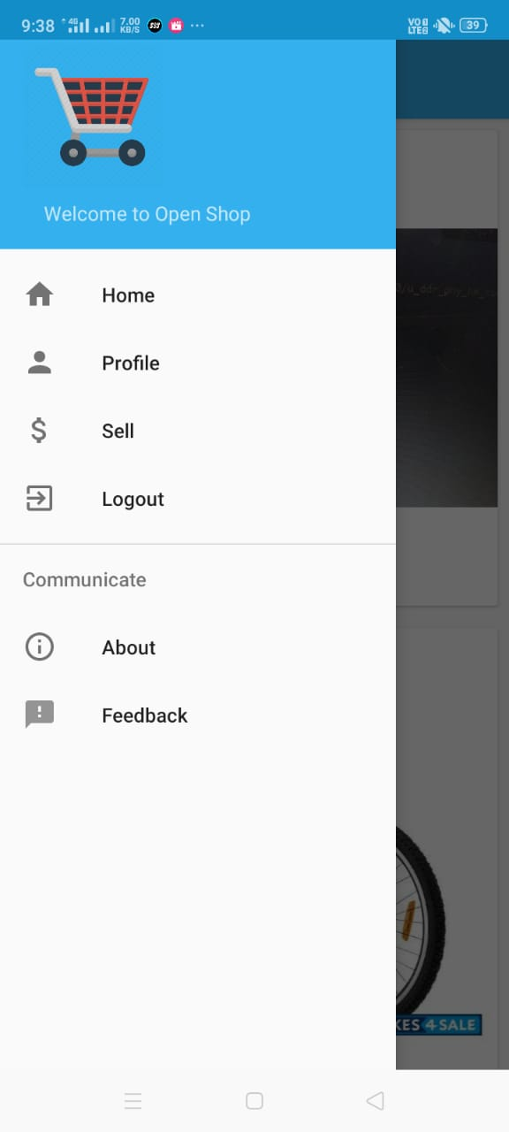
Navigation Bar
Profile: For updating your profile
Sell: Foir selling your products
Logout: For logging out

Slide 22
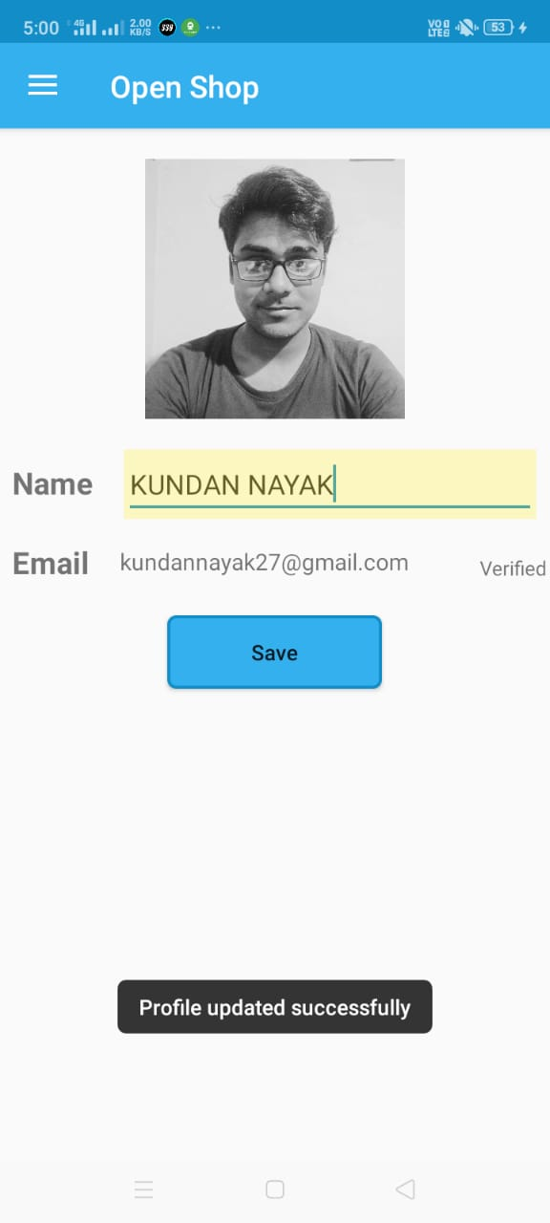
Profile update activity
Very basic activity, just have to upload your display image and name.

Slide 23
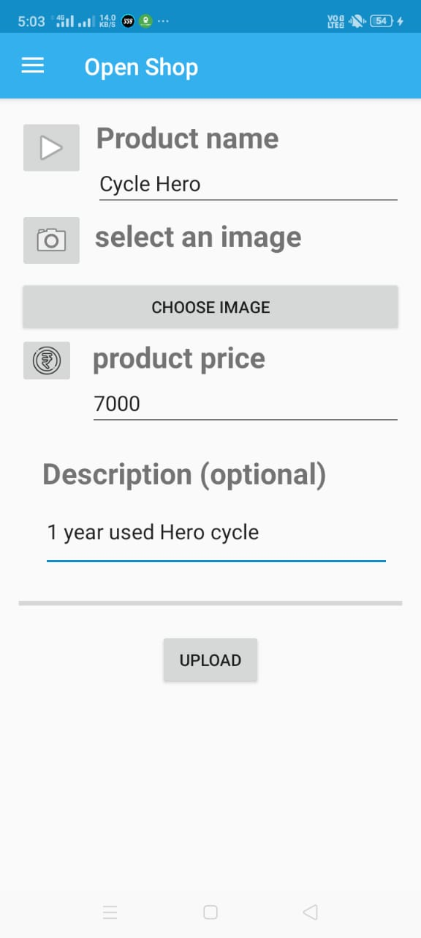
Selling Activity
Fill the name, price, description for your product andupload an image.

Slide 24
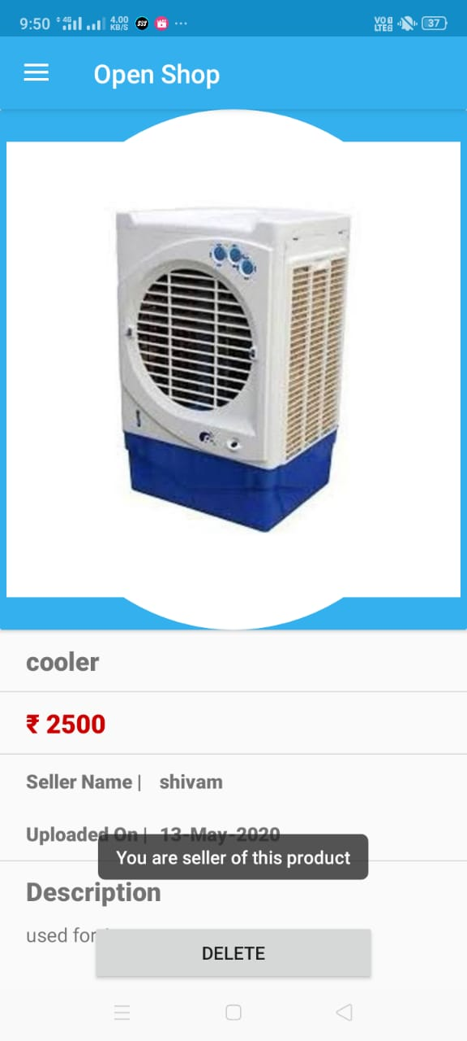
Product Activity for seller
If you are owner of a product you can delete it anytime after clicking on delete button.

Slide 25
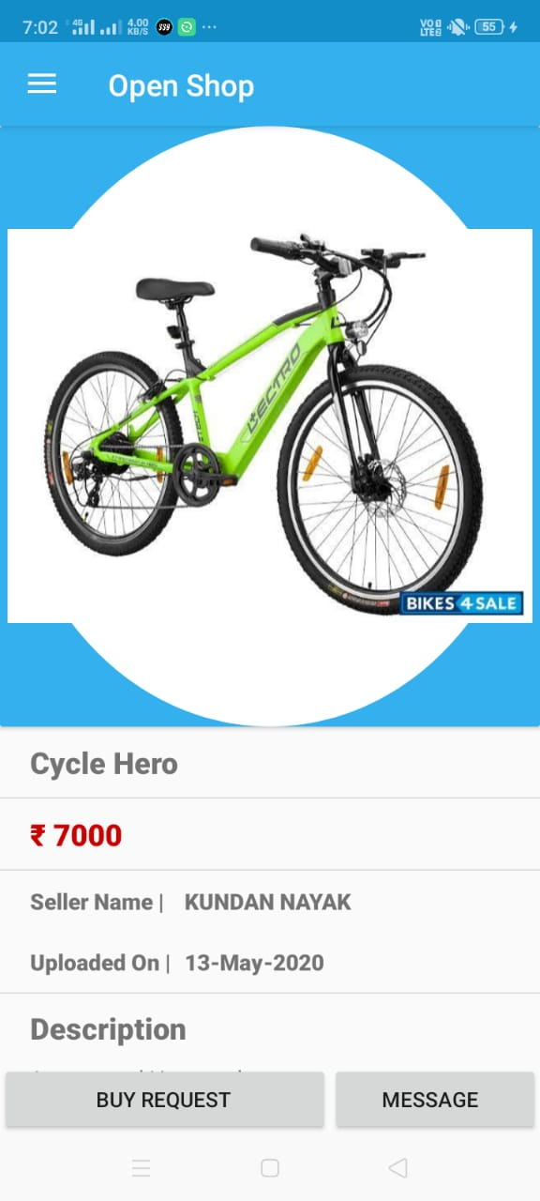
Product Activity for buyer
If you are a buyer, you can either click on BUY REQUEST button to directly send an email to seller to notify that you want to purchase this product or you can click on MESSAGE button to get in contact with seller through email.

Slide 26
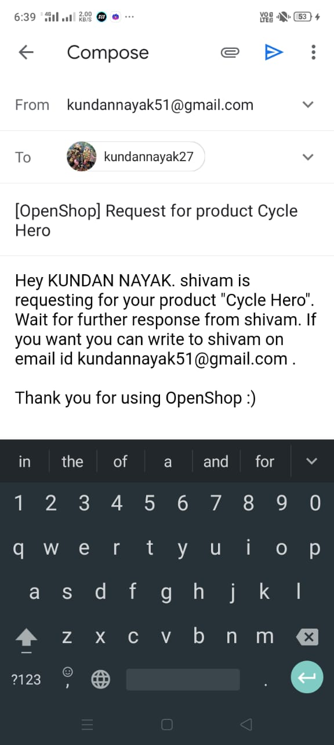
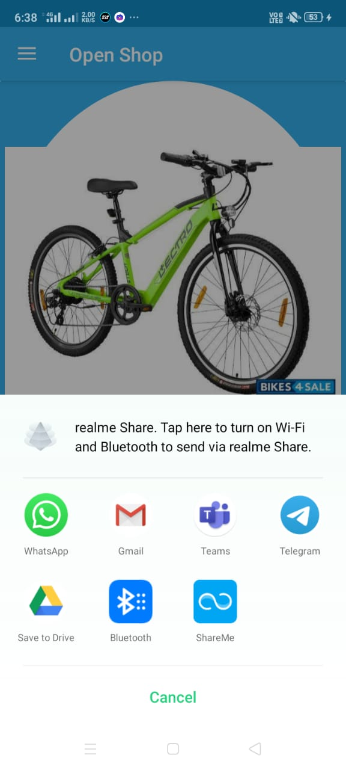
Buy Request Email formait
After clicking on BUY REQUEST

Slide 27
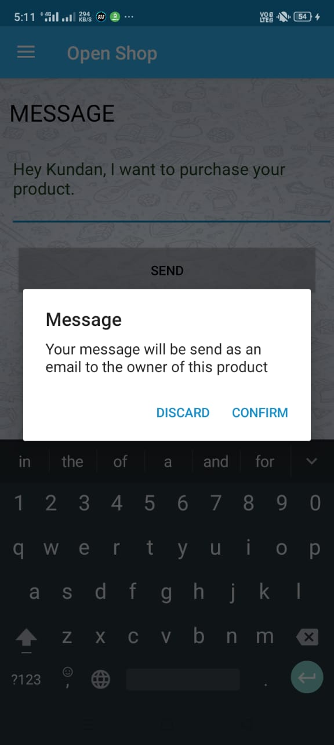
Message

Slide 28
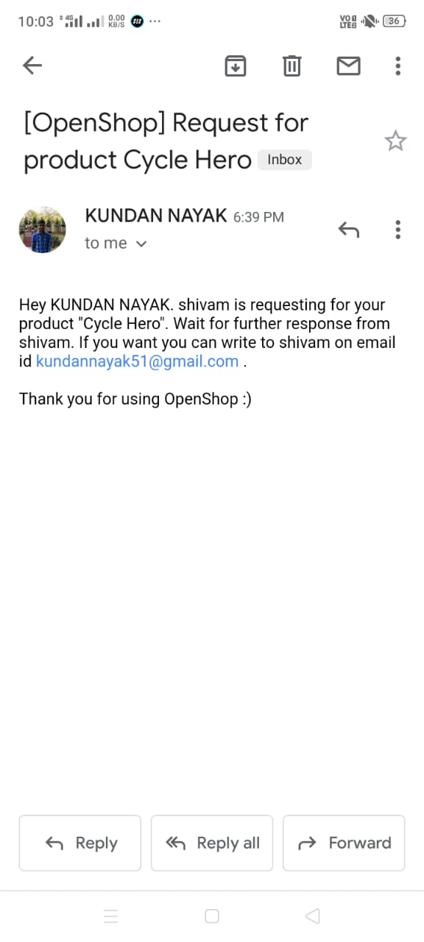
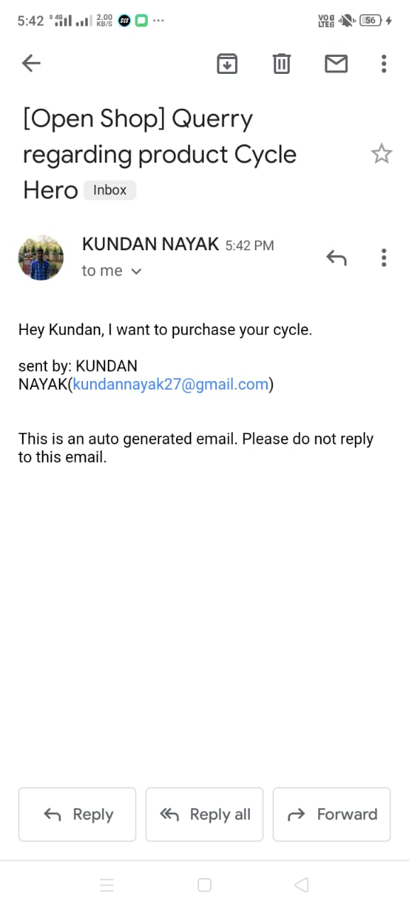
Emails to seller
In case Buyer click on BUY REQUEST button
In Case buyer choose to message seller.

Slide 29
Limitations
System is not distributed, so this app may not work on very large datas.
Seller manually have to delete his product.
Products are not categorized.

Slide 30
Future Works
Implementation of searching of products.
Categorizing products.
Chatting within the application.
Payment Options.

Slide 31
Learnings from the project(Conclusion)
As we all teammates were unfamiliar with android development earlier. It was truly a great learning experience. What we learned:
Android Application development fundamental.
Got familiar with working on Android Studio.
Got chance to apply java language and its OOPs concepts.
Use of XML for layout definitions.
Got amiliar with Google's Firebase.

Slide 32
Thank You!

